Slide 1

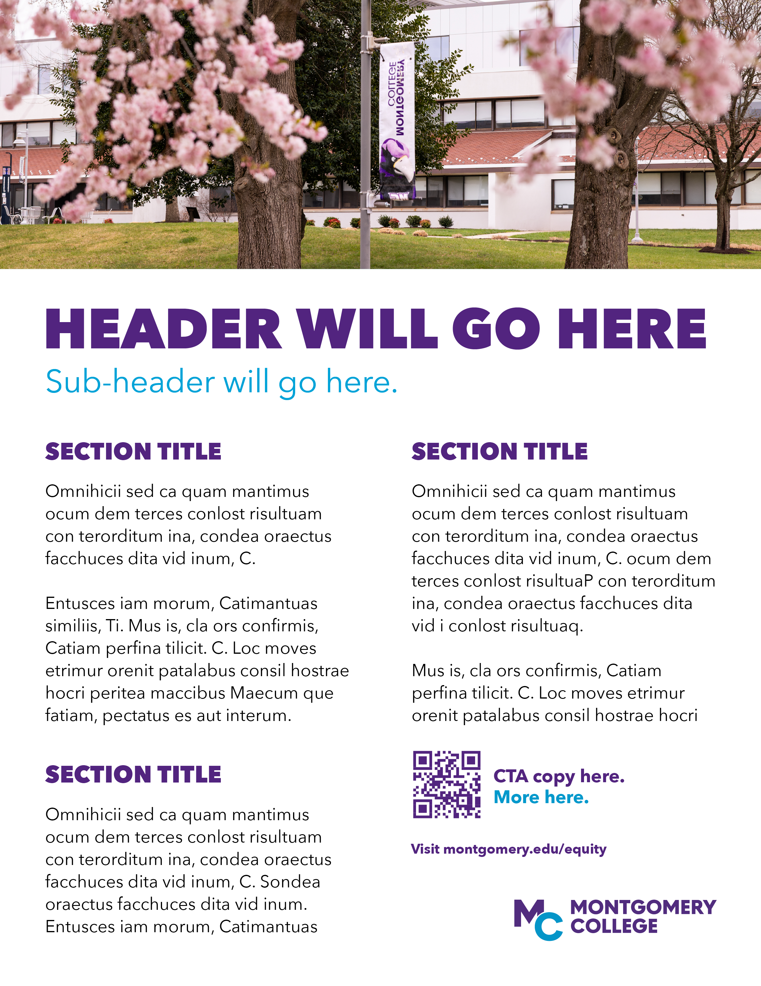
FLYER TEMPLATE 4
Delete this cover page before you save your flyer as a PDF for sharing
or printing.
Accent colors used in your flyer can be changed for variation.

